Slide 1

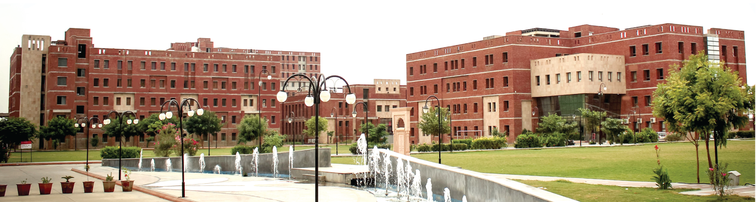
DEPARTMENT OF
Computer Science and Engineering
Minor Project Presentation
On
“Bhagvad Mood Journal”
Presented By:-
Chahat Modi
24BCON0775
Guide:-
Dr. Jitender Kumar
Assistant Professor
2025-2026

Slide 2
Contents
Introduction
Problem Statement
Objectives
Literature Review
Functional Requirements
Non-Funtional Requirements
System Architecture
Data Flow Diagram
ER Diagram
Methodoology
Sentiment Analysis Logic

Slide 3
Algorithm & SQL Mapping
Tools & Technologies
Project Modules
Testing & Verification
Results & Output
Roles & Responsibilities
Conclusion & Future Scope
References

Slide 4
Introduction
Background
Rising student stress
Emotional burnout increasing
Need for wellness support
Psychology + philosophy integration
Motivation
Bhagavad Gita builds resilience
Need for cultural wellness guidance
Apps rely on cloud storage
Privacy concerns in existing apps
Core Problem Addressed
Sensitive emotional data stored online
Generic mood trackers lack deeper guidance
Poor crisis and distress detection
Lack of private offline wellness solutions
Bhagvad Mood Journal

Slide 5
Problem Statement
Designed for all age groups above 10 years
Supports students, professionals, elderly, and remote users
Existing apps depend on cloud storage
Privacy risks for emotional data
Generic mood tracking systems
Lack of spiritual wellness guidance
Weak distress detection support
Need for secure offline wellness platform
Combines NLP with Bhagavad Gita guidance

Slide 6
Objectives
01
02
Build a Tkinter-based journaling application
Use NLP for mood classification
03
04
Provide Bhagavad Gita based guidance
Ensure secure offline data storage
05
06
Track emotional and wellness patterns
Promote emotional resilience and self-reflection

Slide 7
Literature Review
Bhagavad Gita supports cognitive restructuring
NLP improves emotional pattern detection
01
02
Existing apps lack privacy-first architecture
Cloud-based systems risk data security
03
04
Spiritual guidance improves emotional resilience
05

Slide 8
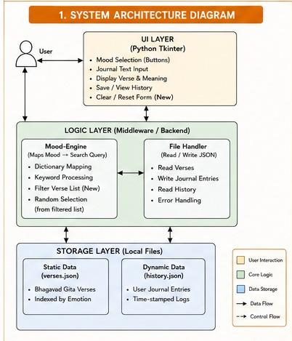
System Architecture
GUI Layer using Tkinter
Authentication Module
Sentiment Analysis Engine
Shloka Recommendation Engine
SQLite/MySQL Database
CRUD and Analytics Module

Slide 9
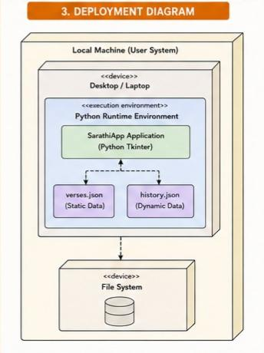
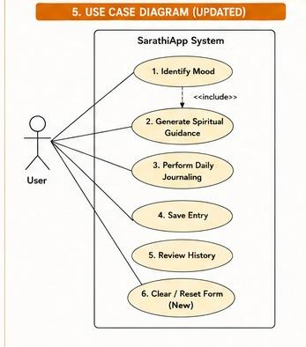
Deployment Diagram & Use Case Diagram

Slide 10
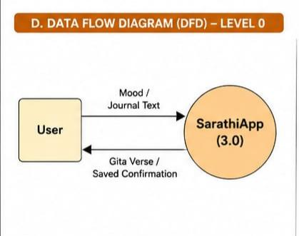
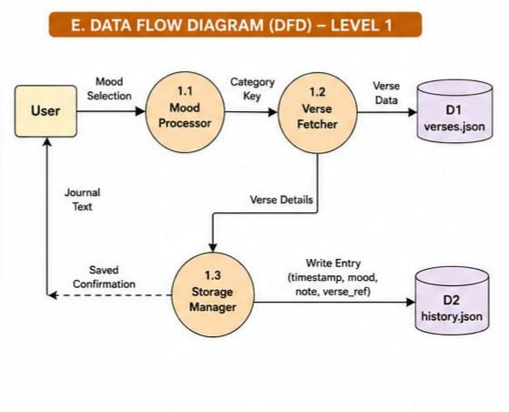
Data Flow Diagram

Slide 11
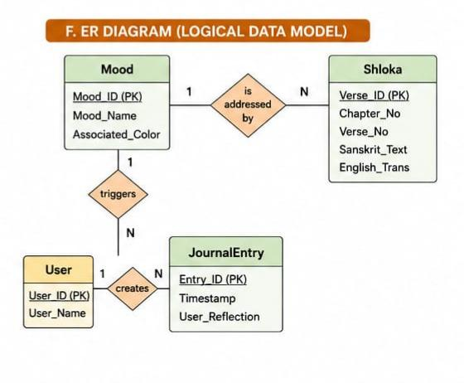
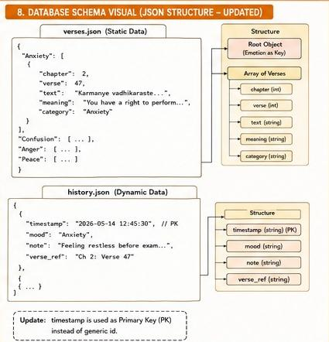
ER Diagram

Slide 12
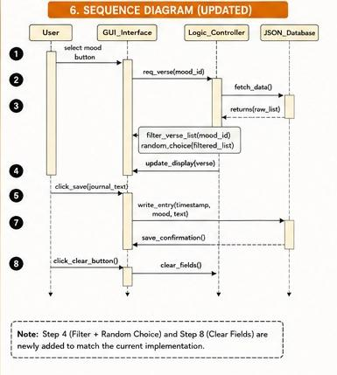
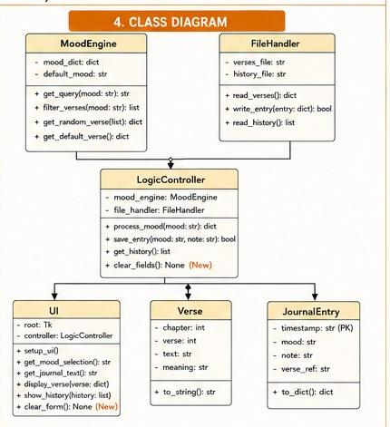
Sequence Diagram & Class Diagram
Sequence Diagram
Class Diagram

Slide 13
Requirements
01
02
Functional Requirements
Non-Functional Requirements
Secure user registration and login
Emotional journaling and CRUD operations
NLP-based mood detection
Bhagavad Gita shloka recommendation
Period and wellness tracking
Data visualization and analytics
Crisis keyword detection using regex
CSV export and history management
Fully offline application
Privacy-first architecture
Lightweight desktop performance
Fast response and query speed
User-friendly GUI design
Reliable local database storage

Slide 14
Methodology
01
02
Approach Used
Offline desktop-based wellness application
MVC-inspired modular architecture
NLP-based emotional analysis system
Processes Used
User writes journal entries
TextBlob extracts sentiment polarity
Mood mapped to spiritual categories
Relevant shloka displayed instantly
Entries stored in local database

Slide 15
Sentiment Analysis Logic
Module used :
Uses TextBlob NLP library
Logic used :
Extracts sentiment polarity from text
P∈[−1.0,1.0]
P<−0.2 → Anxiety/Sorrow
P>0.3 → Peace/Gratitude

Slide 16
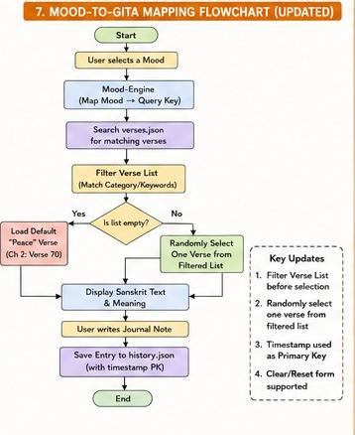
Algorithm & SQL Mapping
Mood Mapping
Anxiety → Chinta
Fear → Bhay
Peace → Shanti
SQL Query & Mapping
SELECT shloka, translation
FROM shloka_library
WHERE mood_tag = %s
LIMIT 1;

Slide 17
Tools & Technologies
Software & Programming
Python 3.10+
Framework & Libraries
Tkinter / CustomTkinter
MySQL
TextBlob & NLTK
Matplotlib
tkcalendar
Regex
Pillow(PIL)
CSV
Hardware Requirements
Intel i5 / Ryzen 5 or above
8GB–16GB RAM
256GB SSD or higher
Development Tools
VS Code
Git & GitHub

Slide 18
Roles & Responsibilities
Roles & Responsibilities
Team Member Name: Chahat Modi
Research gap identification
GUI and frontend development
Backend and database integration
NLP sentiment analysis implementation
Shloka mapping and feature integration
Testing, debugging, and documentation

Slide 19
Implementation
Modules Developed
main.py
Controls application workflow and navigation
login_page.py
Handles authentication and validation
dashboard.py
Manages CRUD journaling operations
logic.py
Performs sentiment analysis and shloka mapping
db_handler.py
Handles database connectivity and queries
Code Snippet
from textblob import TextBlob
blob = TextBlob(text)
polarity = blob.sentiment.polarity
if polarity < -0.2:
mood = "Anxiety"

Slide 20
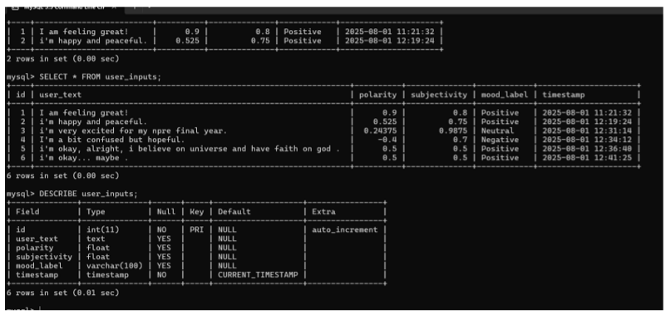
Glimpse Of Database & MySQL Queries

Slide 21
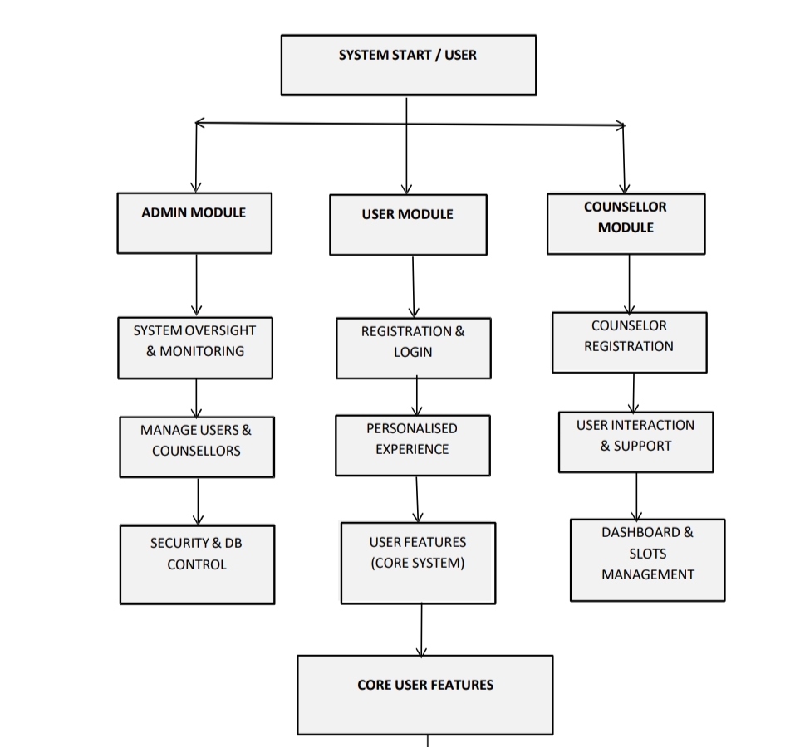
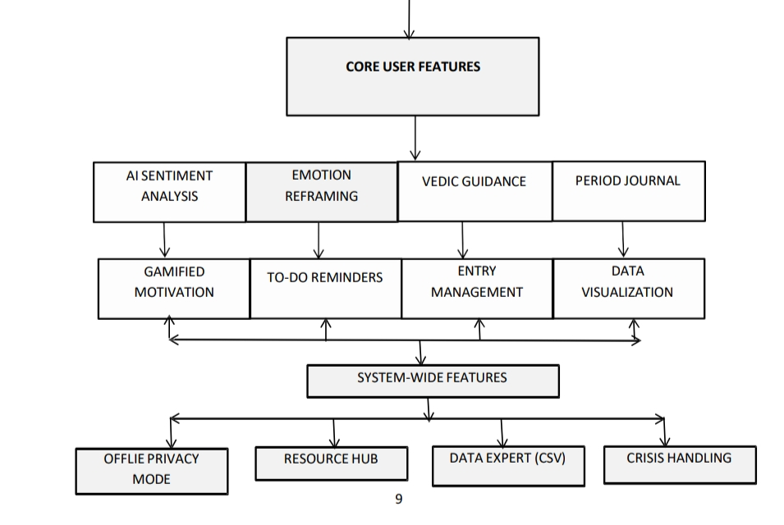
Project Features

Slide 22
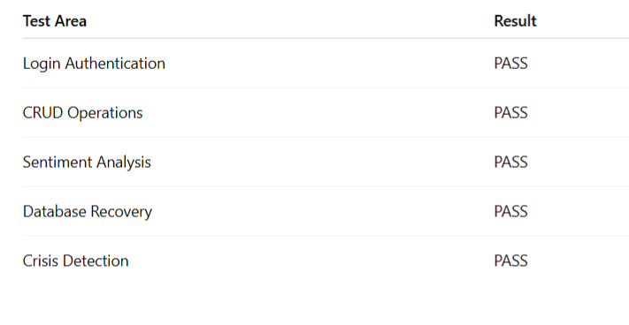
Results & Output
Observations
Secure offline journaling achieved
Accurate mood classification using NLP
Instant Bhagavad Gita guidance displayed
Lightweight and responsive interface
Performance Metrics
Query Speed < 50ms
NLP Processing < 0.1 sec
Memory Usage: 60–80MB

Slide 23
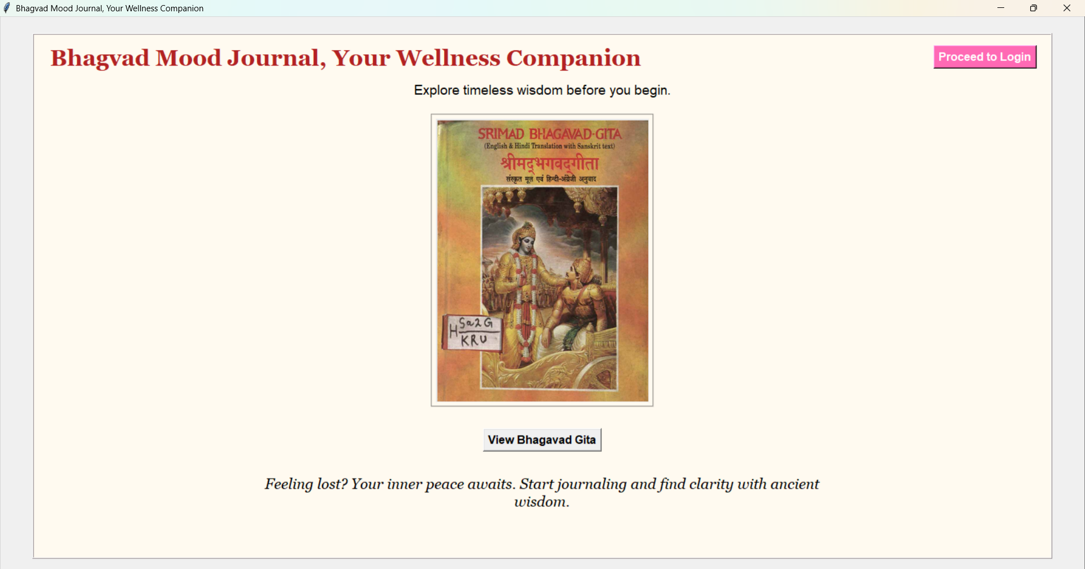
Walthrough the Desktop Application & Glimpses

Slide 24
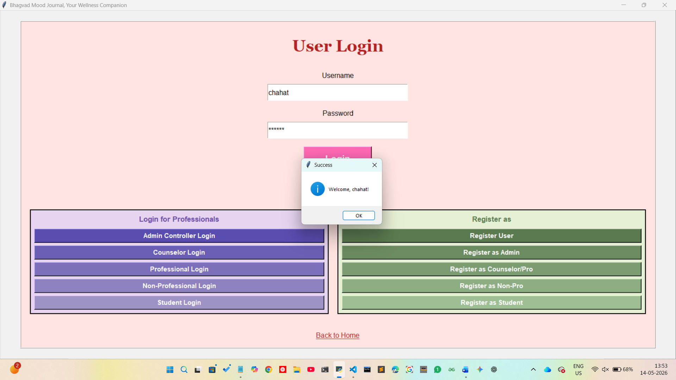
Results & Output

Slide 25
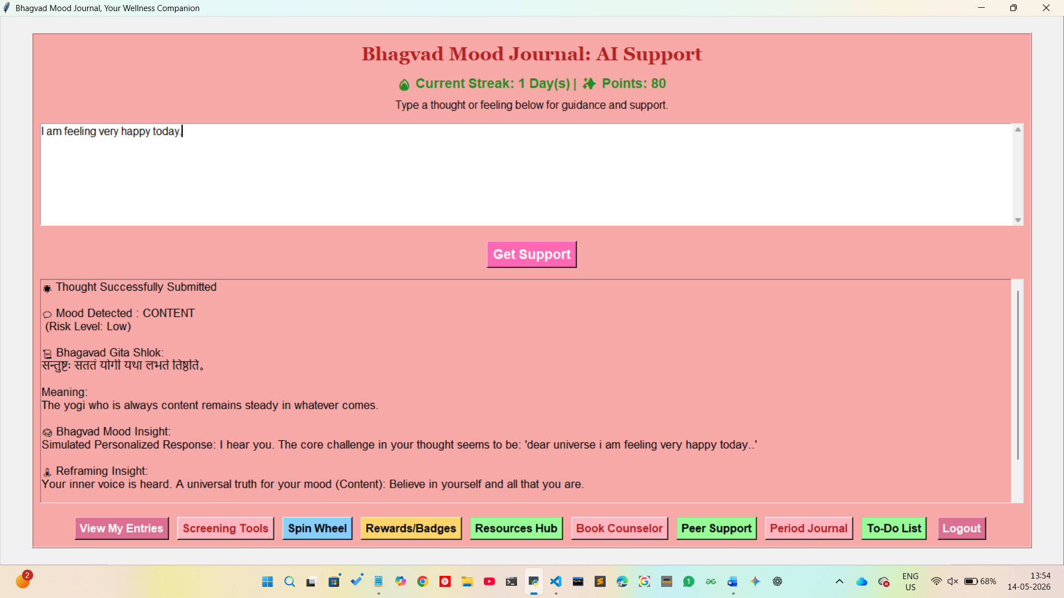
Dashboard and User Journal

Slide 26
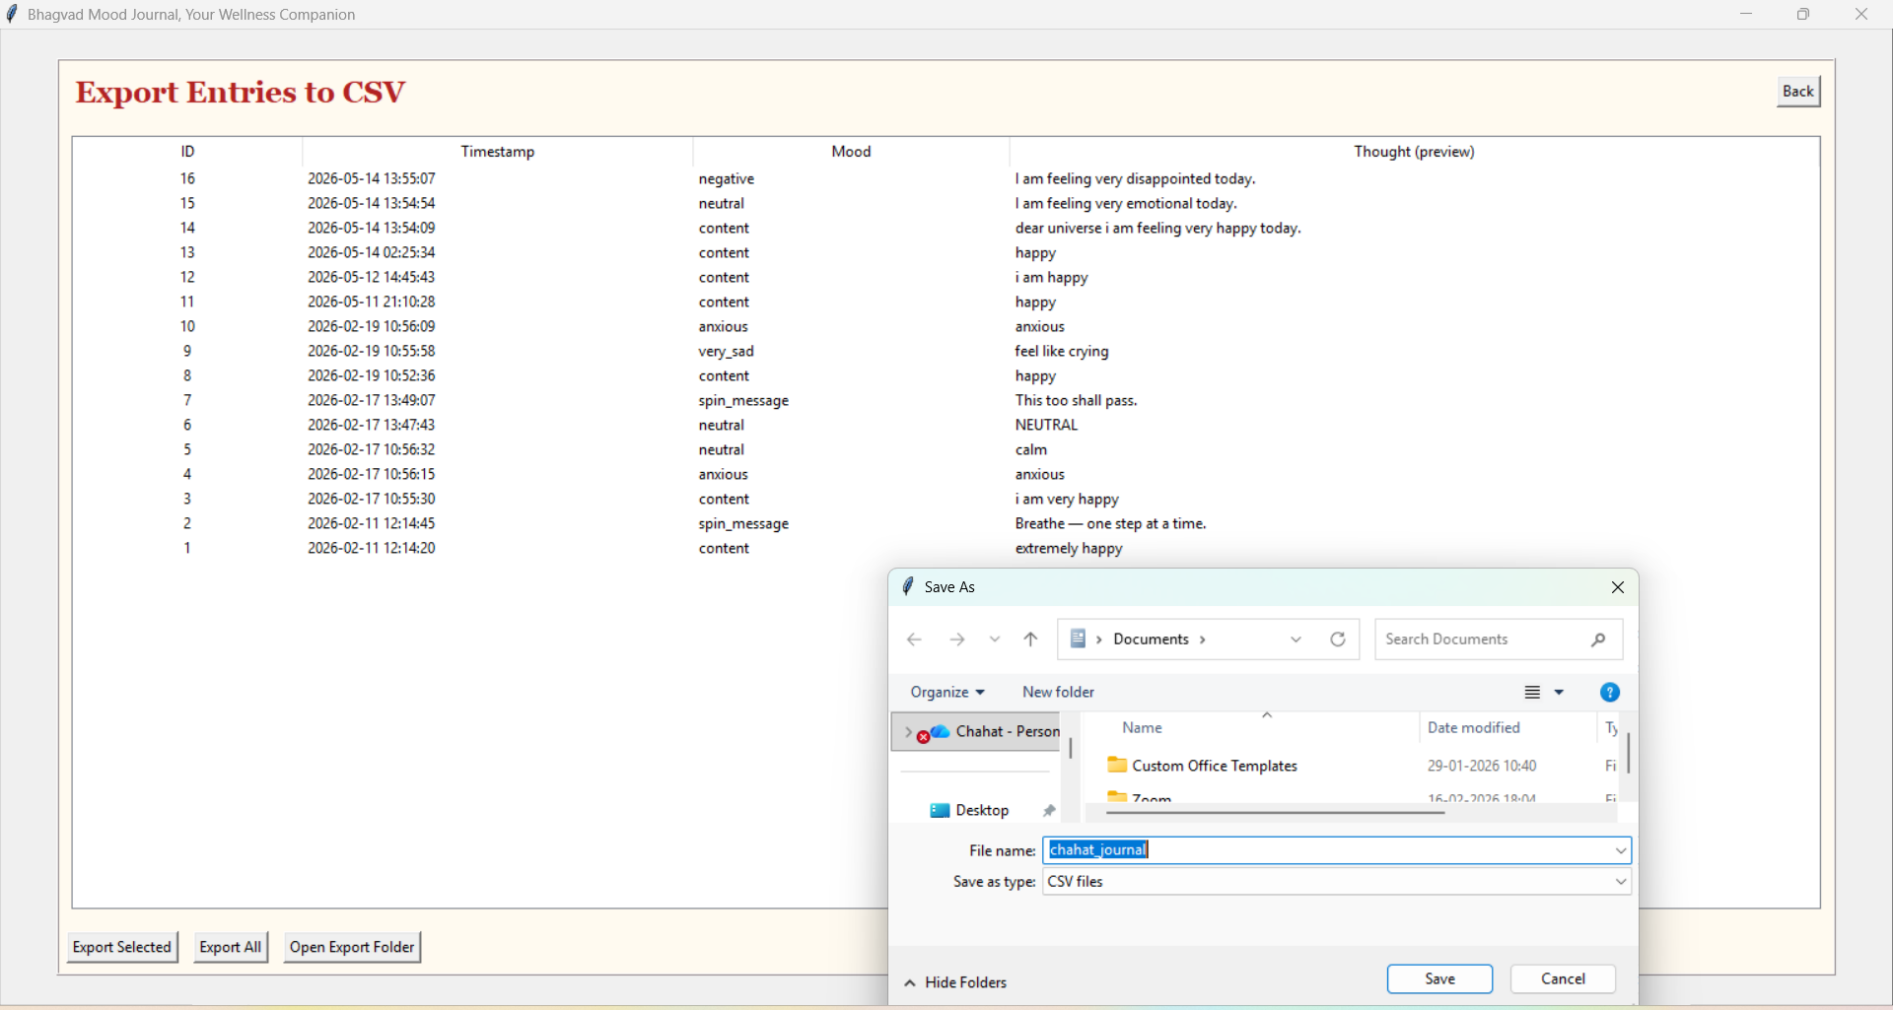
Features

Slide 27
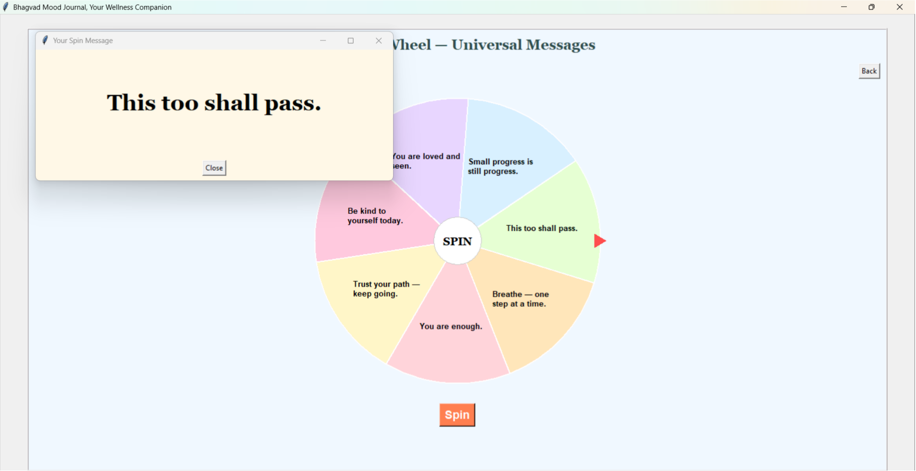
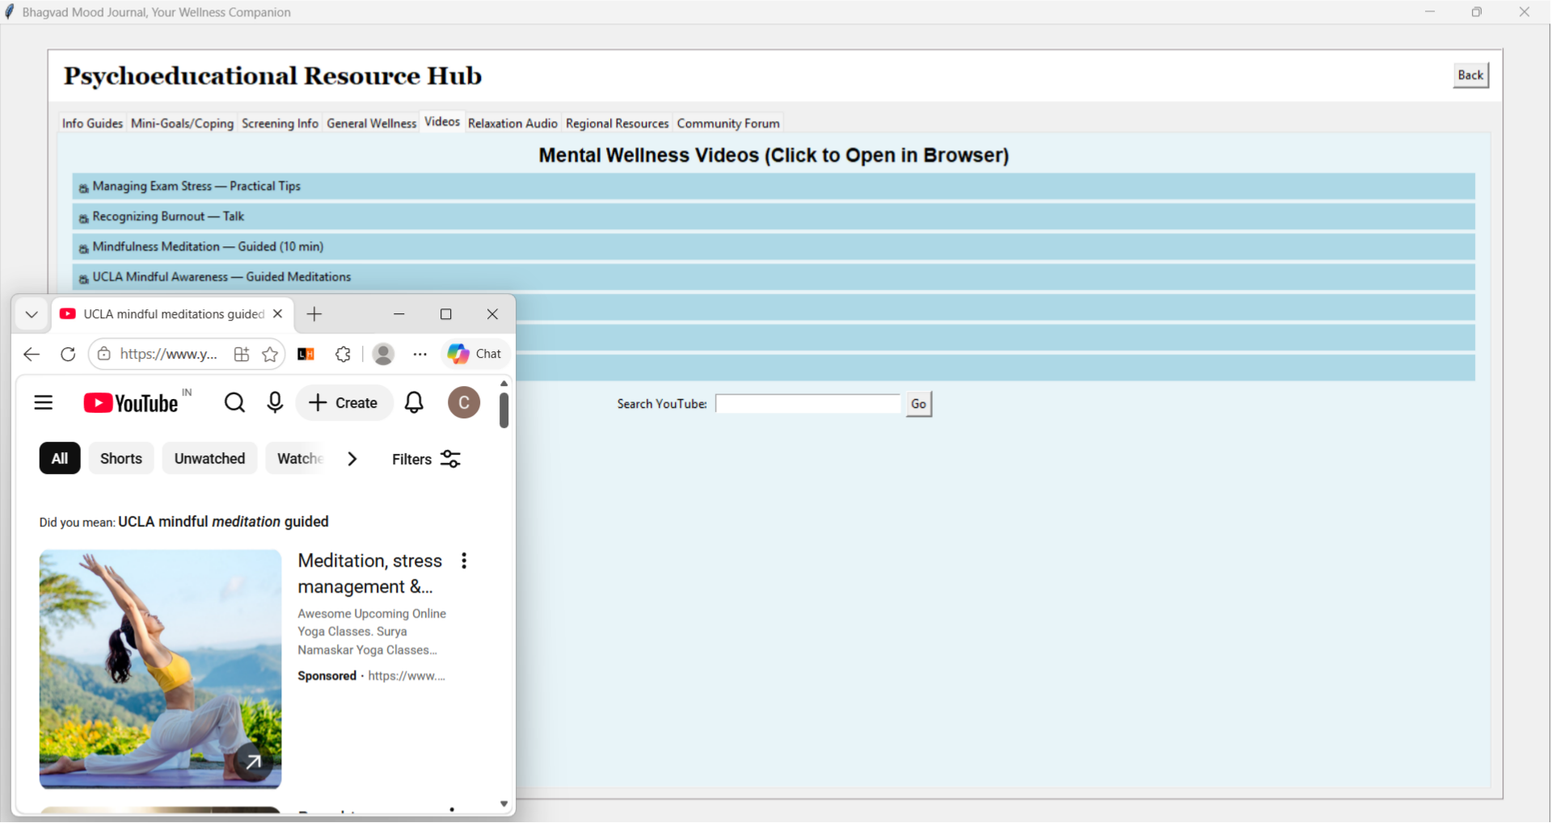
Glimpse of of app engagement Features

Slide 28
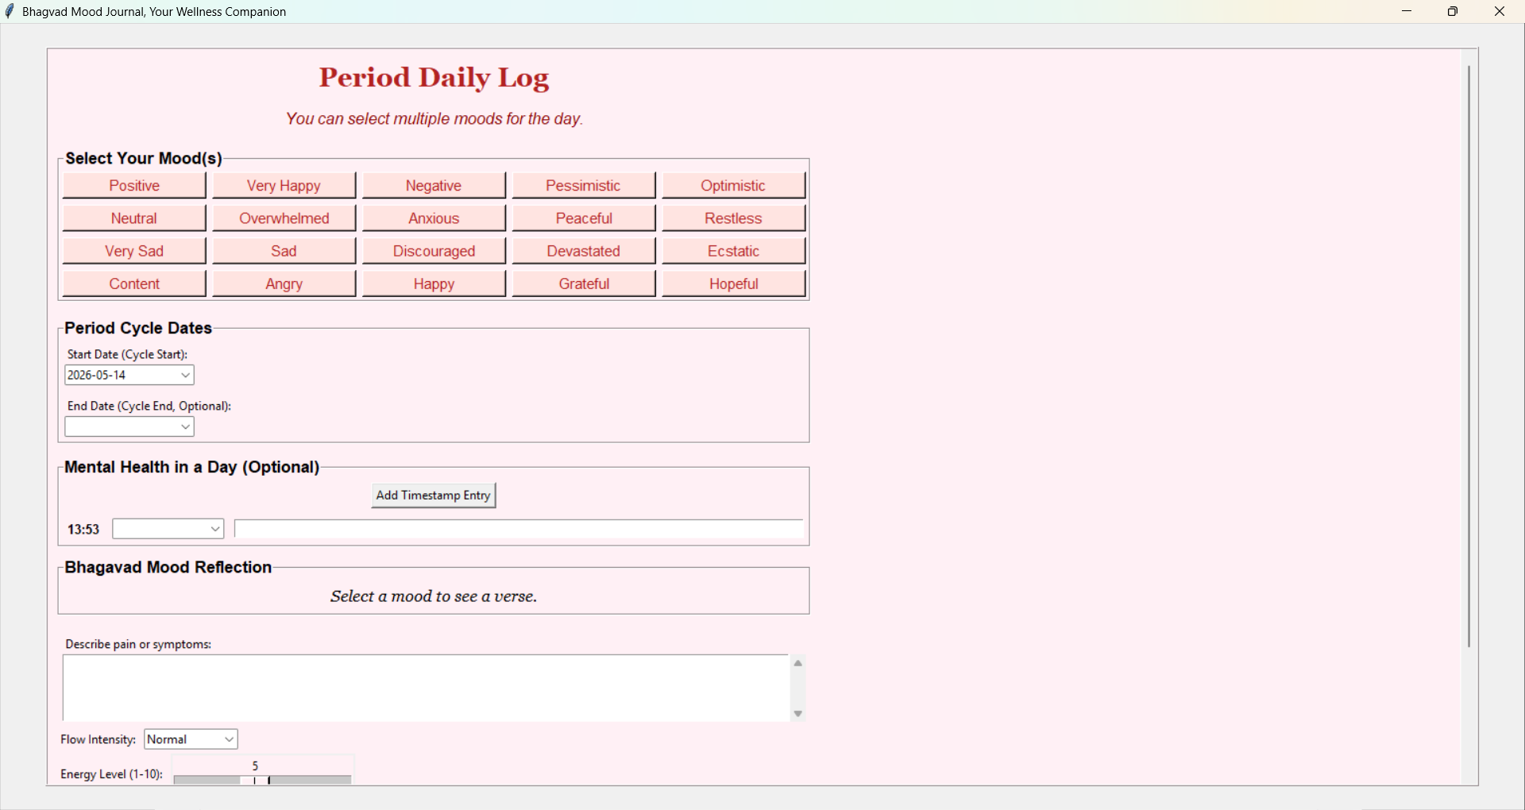
Target Audience : Women ( & Their Mental Health )

Slide 29
Conclusion
Ensured user privacy through local storage
Improved emotional self-reflection and resilience
Combined NLP with Bhagavad Gita guidance
Provided lightweight and user-friendly interface
Conclusion
Developed a secure offline wellness platform
Bridged technology with spiritual wellness concepts

Slide 30
Limitations & Future Scope
01
02
Limitations
Future Enhancements
Desktop-only application
English-focused sentiment analysis
Limited spiritual repository
Offline LLM integration
Mobile application support
Multi-language support
Wearable device integration
Advanced predictive analytics

Slide 31
References
[1] E. S. Rao and A. C. Paranjpe, “The Bhagavad Gita: A framework for psychological resilience and cognitive restructuring,” *Indian Journal of Psychological Medicine*, vol. 38, no. 4, pp. 312–319, 2016.
[2] National Center for Biotechnology Information (NCBI), “Stress reduction potential of Bhagavad Gita and Yoga,” *PMC Research Paper*, 2026.
[3] “Sentiment Analysis for Mental Health: Challenges and Opportunities.” ResearchGate.
[4] Jhalak19y, “MindLens AI Mental Health Analyzer.” GitHub Repository.
[5] “Mental Health Analysis using NLP Techniques.” Research Archive Journal.
[6] “Global Mental Health.” Wikipedia.
[7] Bhatia, S. C., & Bhatia, S. K., *The Bhagavad Gita: A Precursor to Modern Psychotherapy*, 2005.
[8] *Mental Health in Ancient India & Its Relevance to Modern Psychiatry*, IJPsy-41-5.pdf.
[9] Wysa, “AI-Driven Mental Health Support,” 2026.

Slide 32
THANK YOU
Open for discussion

